Slide 1
What makes sense in biology?
Daniel Garza
(KU Leuven, Belgium & Balance of the Microverse, Germany)

Slide 2
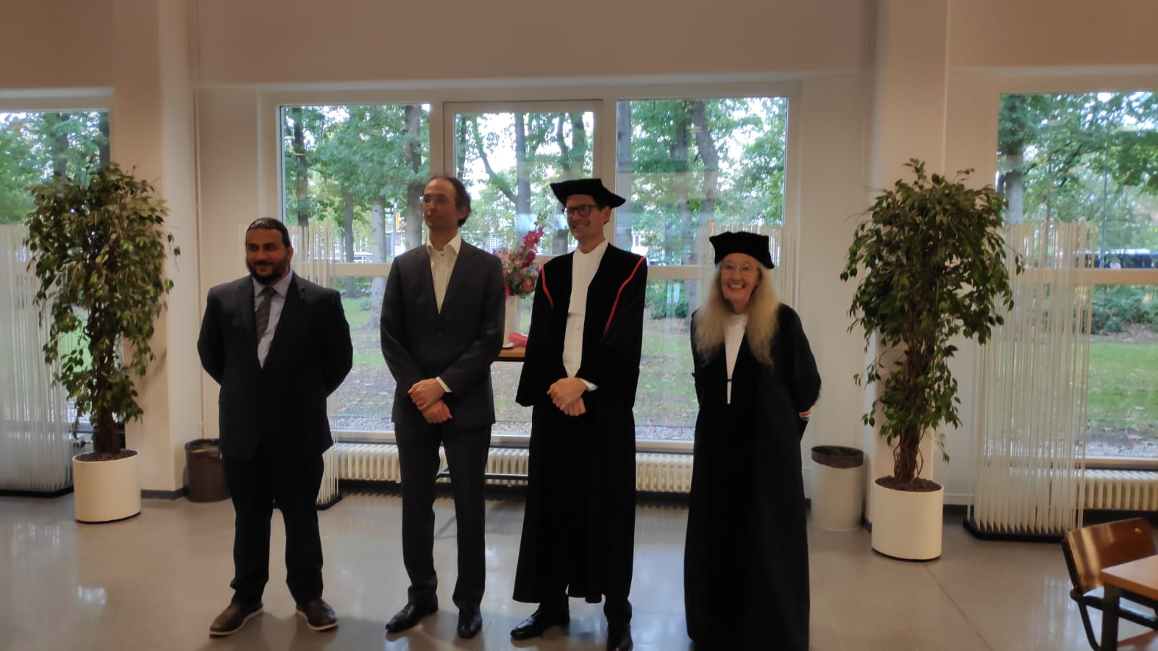
Prof. Bas Dutilh
Prof. Martijn Huijnen
Prof. Paulien Hogeweg

Slide 3
Prof. Bas Dutilh
Prof. Martijn Huijnen
Prof. Paulien Hogeweg

Slide 4



Dr Bram Van Dijk
Dr Hilje Doekes
Prof. Paulien Hogeweg
“Nothing in biology makes sense except in the light of evolution”

Slide 5
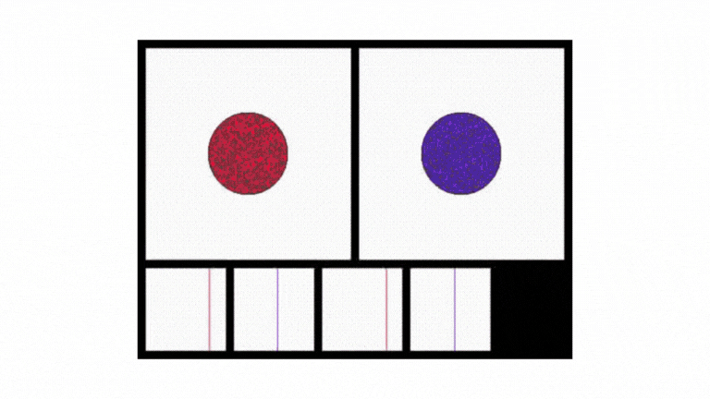

Dr Bram Van Dijk
Dr Hilje Doekes
Prof. Paulien Hogeweg
“Nothing in biology makes sense except in the light of evolution spatial structure”

Slide 6
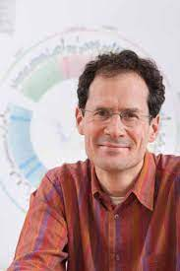
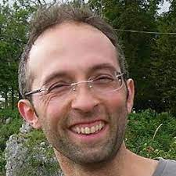
Prof. Bas Dutilh
Prof. Martijn Huijnen
“Nothing in biology makes sense except in the light of evolution spatial structure”

Slide 7
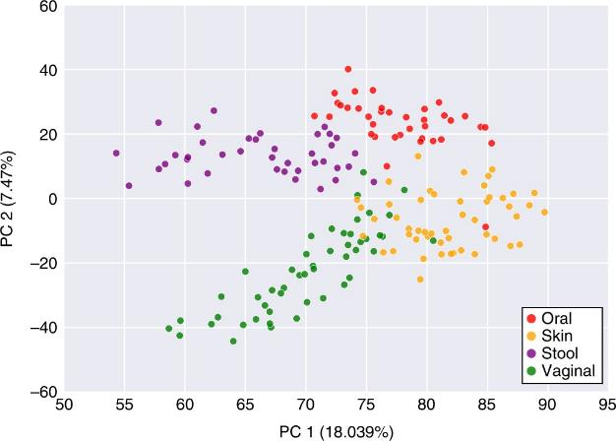
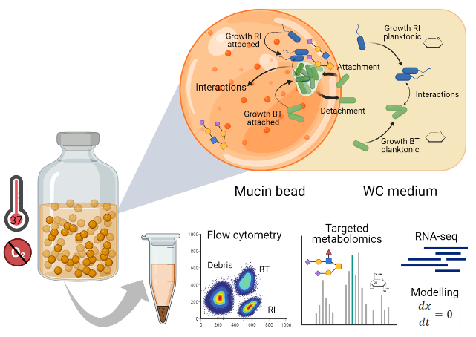
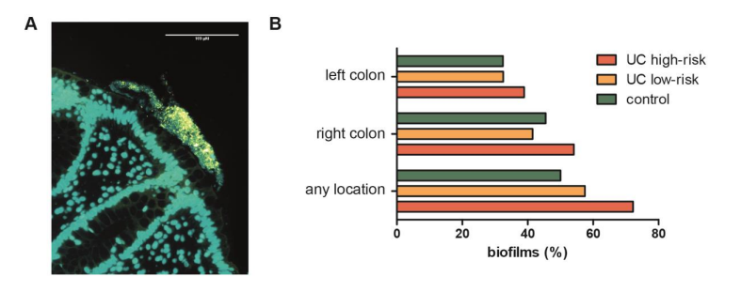
Prof. Martijn Huijnen
Prof. Bas Dutilh
Garza et al. Nat Microbiol 2018
“Nothing in biology makes sense except in the light of evolution spatial structure data”
Bruggeling, Te Groen & Garza et al. J Crohns Colitis (2023)
Liu & Garza et al. ISME J (2023, in press)

Slide 8
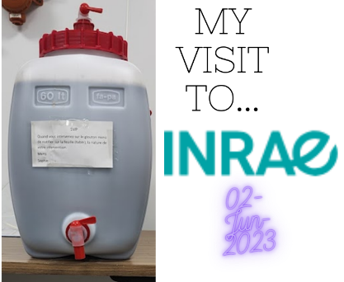
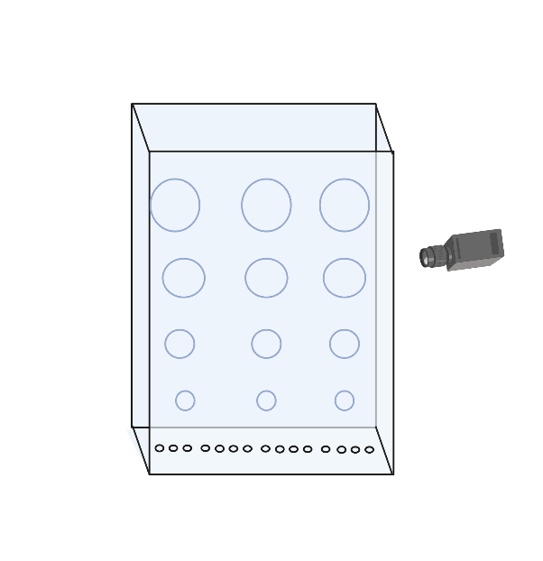
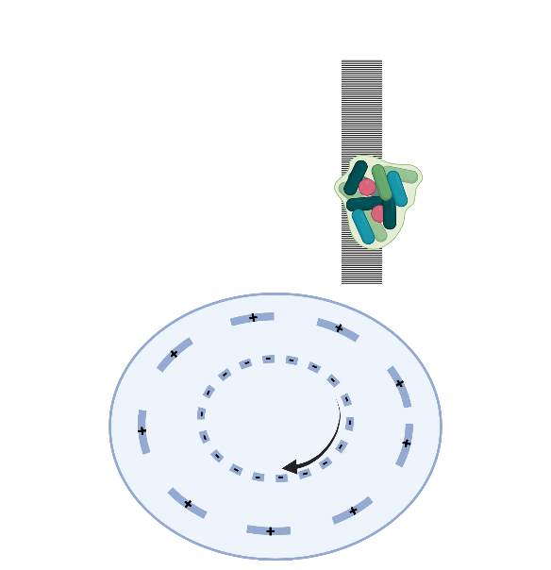
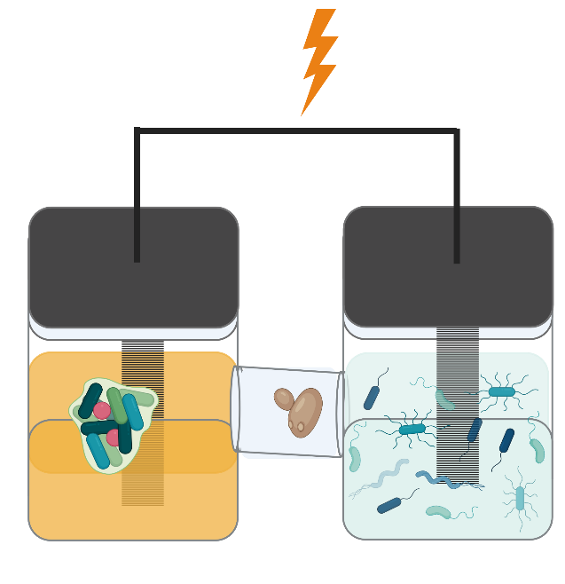

Slide 9
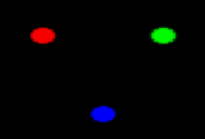
Data-driven modeling of microbial ecosystems
Data collection & analyses: Team-up with researches and engineers that already created the tools to track spatially-resolved data
Model development: Develop mathematical frameworks that connect the dots between the spatial distribution of environmental factors and the structure, function, and control of microbial systems
Knowledge exchange: organize a theoretical and practical forum for data-driven spatial modeling of microbial systems. Consisting of lectures from authors of key studies, who can also provide a hands-on tutorial for the exchange of knowledge (coding and engineering systems)

Slide 10
“Nothing in biology makes sense except in the light of evolution spatial structure data”

Slide 11
“Nothing in biology makes sense except in the light of evolution spatial structure data its mechanisms”

Slide 12
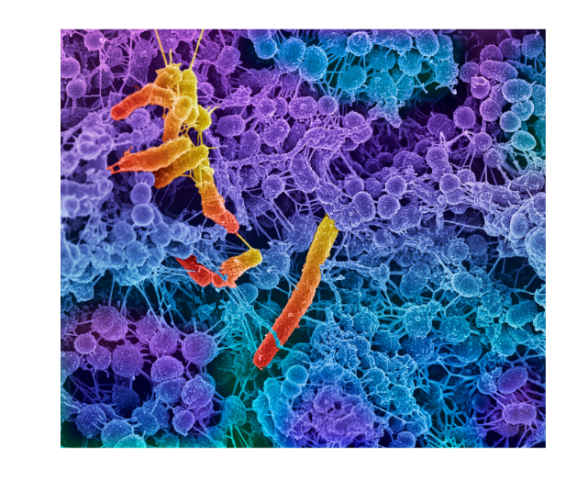
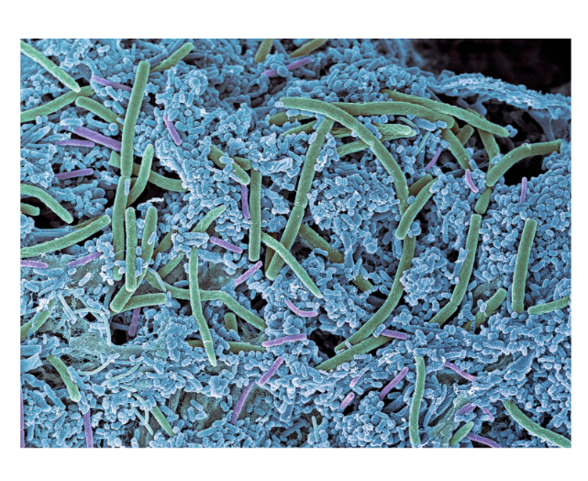
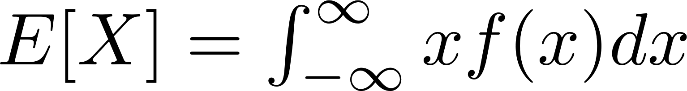
Is my community stable?
Is it performing its desired function?
Will it shift to an alternative state?
How can I optimize its function?

Slide 13
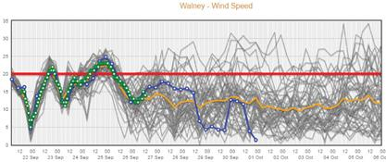
Is my community stable?
Is it performing its desired function?
Will it shift to an alternative state?
How can I optimize its function?

Slide 14
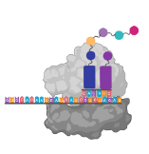
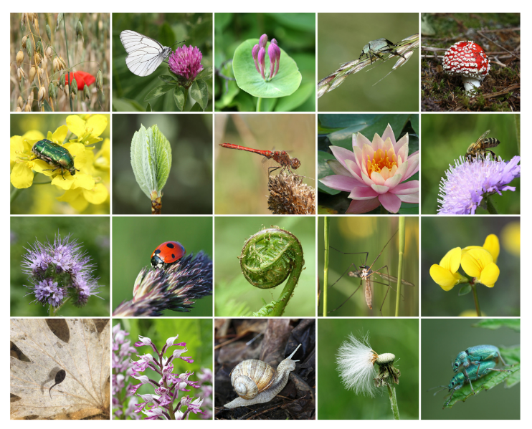
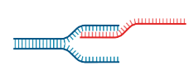
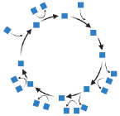
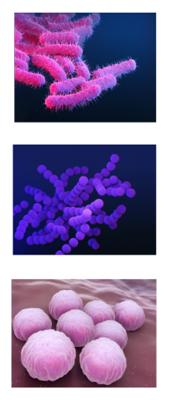
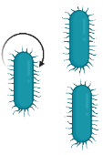

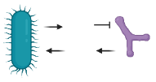

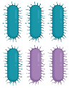
Diversity & Patterns in biology
Gene expression
Translation
Metabolism
Population growth
Environmental conditions
Ecological interactions
Evolutionary dynamics
Notes:
Biodiversity

Slide 15

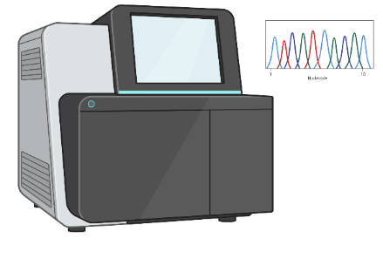
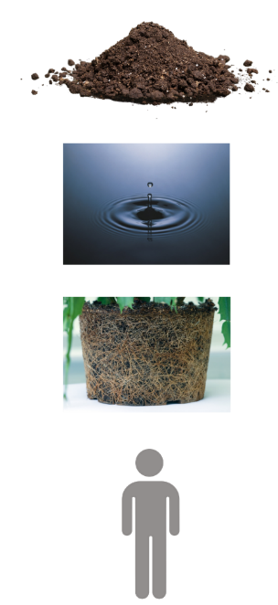
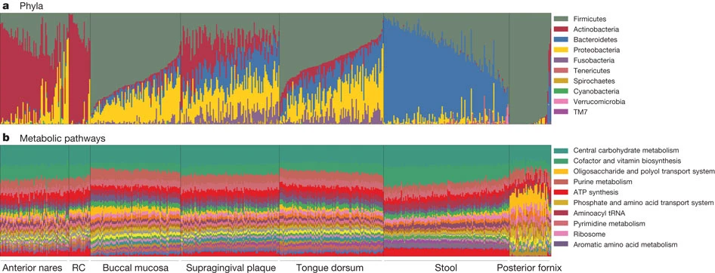
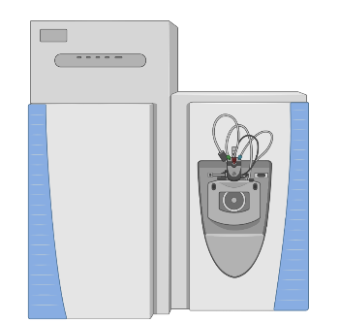
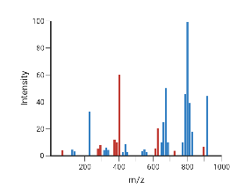
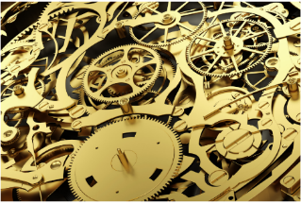
Uncovering patterns in microbial ecosystems
DNA sequencing
Genomes
The Human Microbiome Project Consortium (2020)
Community composition
Mechanism???
metabolomics
Notes:
Information, energy, matter

Slide 16

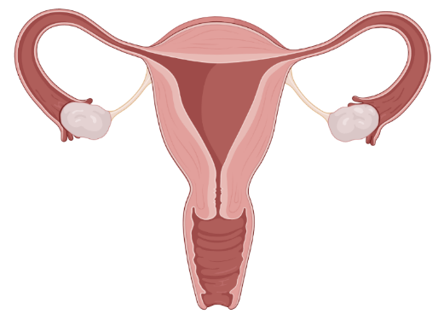
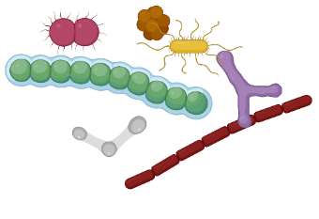

Metabolism explains the composition of bacterial communities
Notes:
Species abundance distribution I

Slide 17
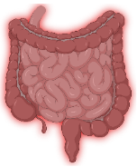
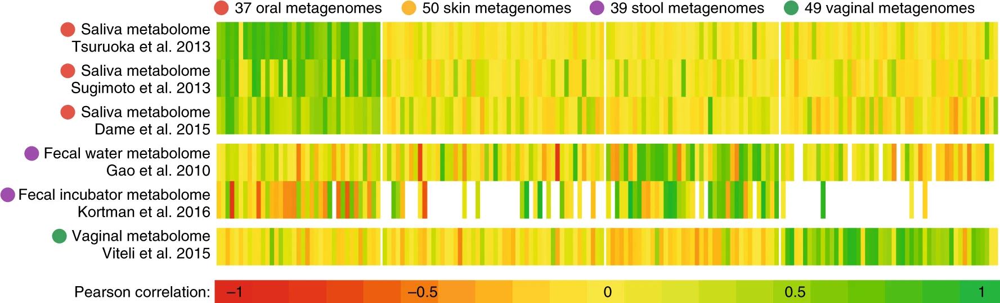

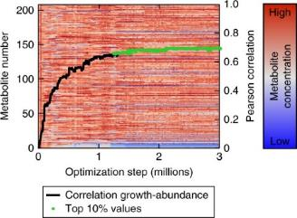
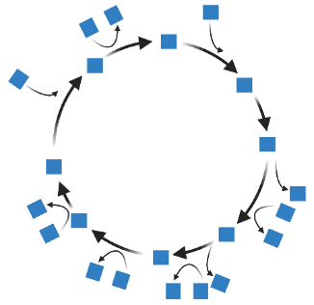






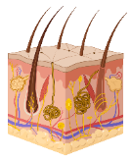

Metabolism explains the composition of bacterial communities

Slide 18
Is my community stable?
Is it performing its desired function?
Will it shift to an alternative state?
How can I optimize its function?

Slide 19
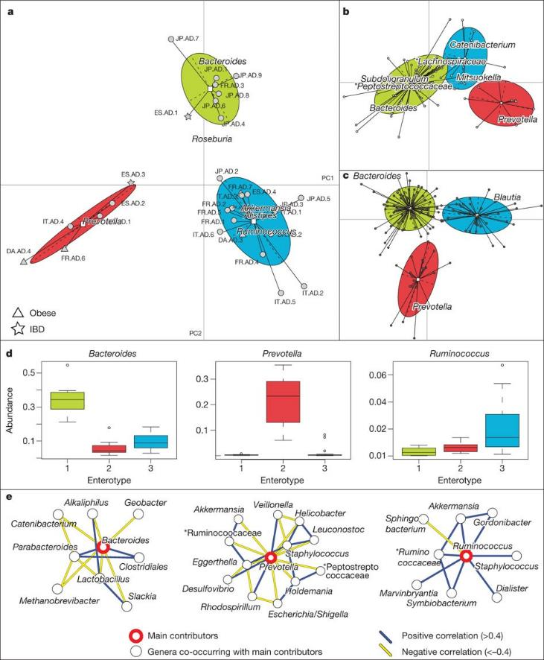
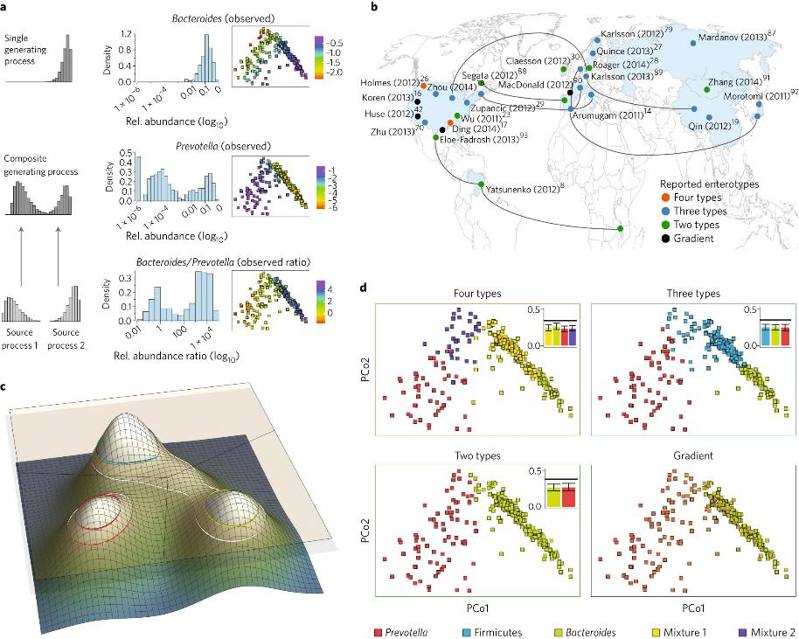
Costea et al. (2017)
Arumugam et al. 2011

Slide 20
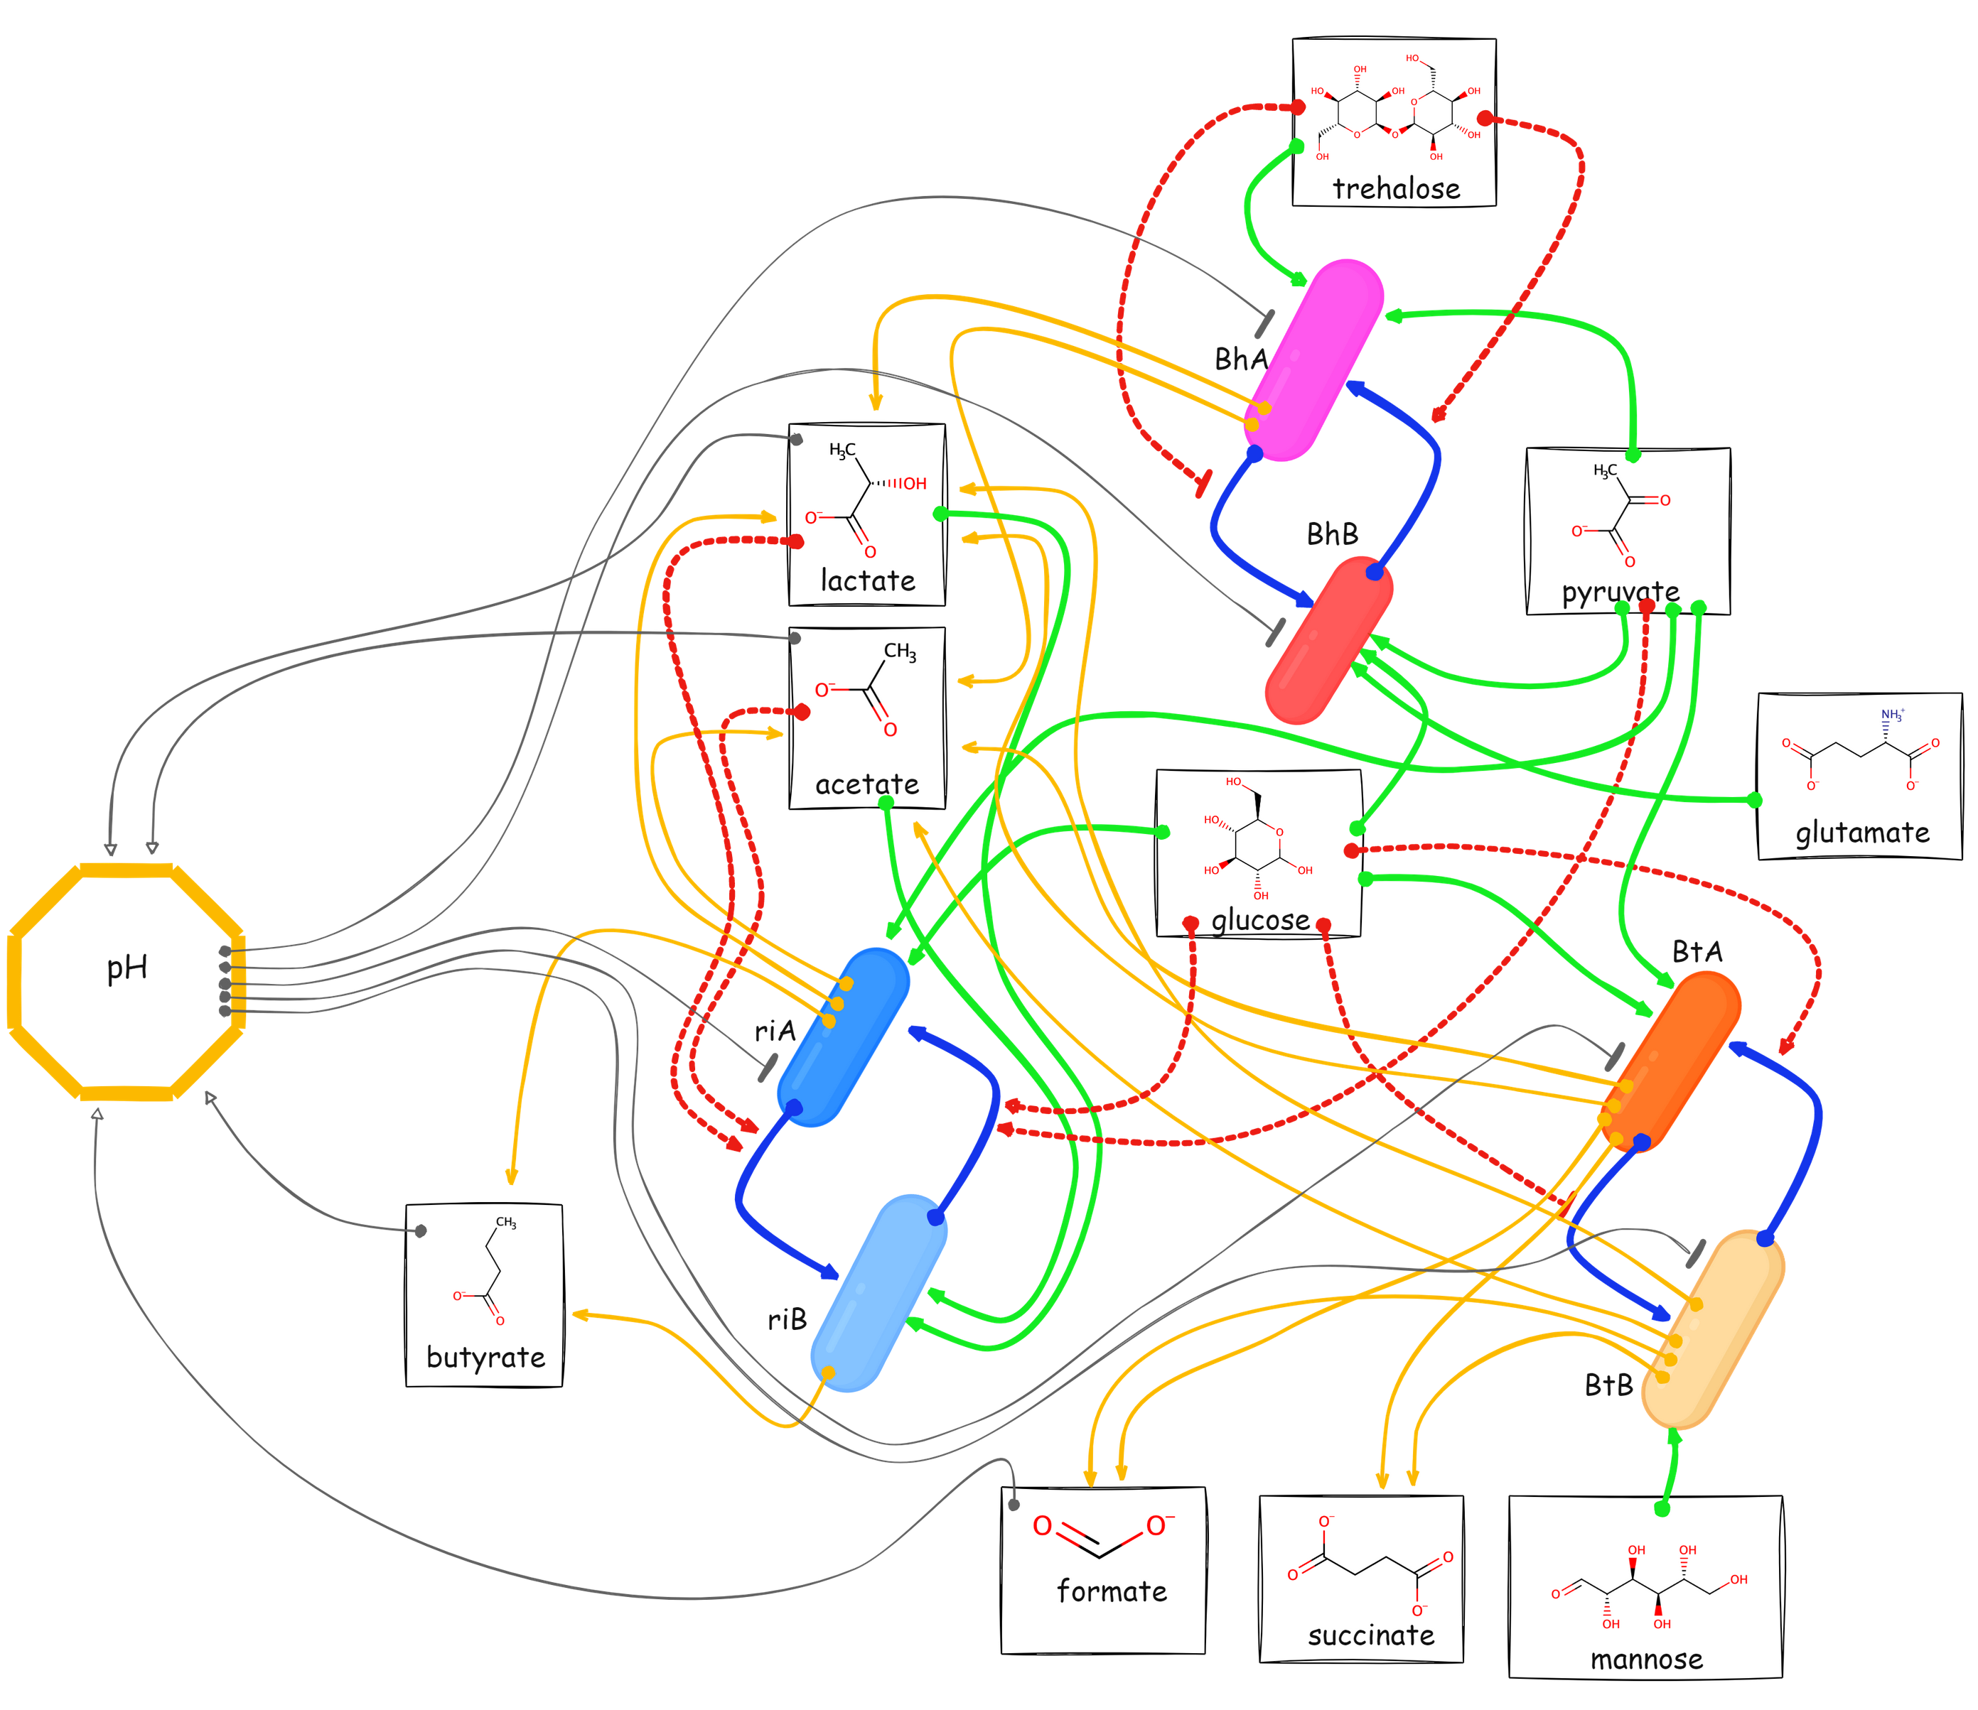
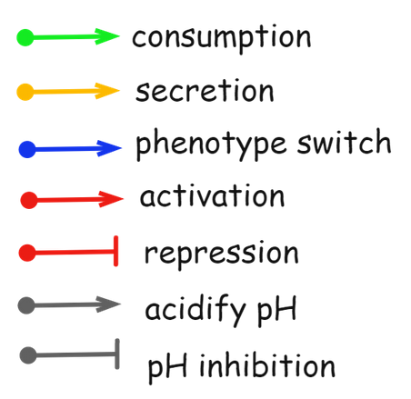
Mechanistic model

Slide 21
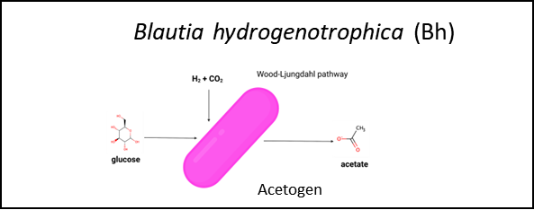
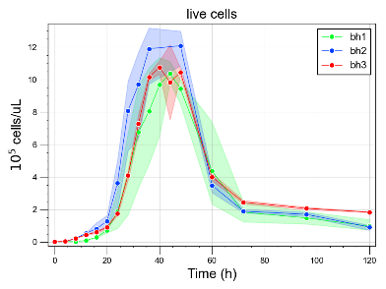
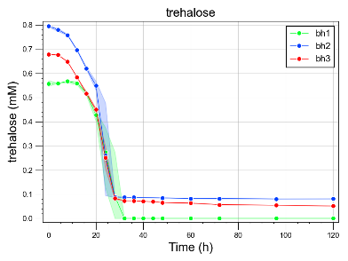
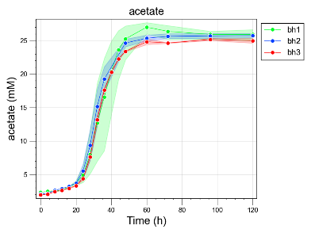
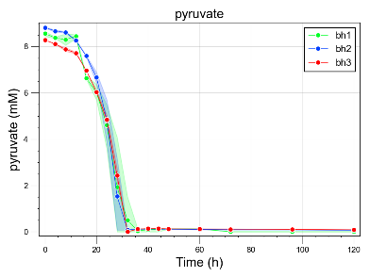
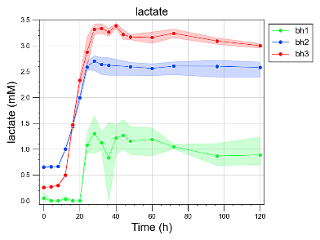
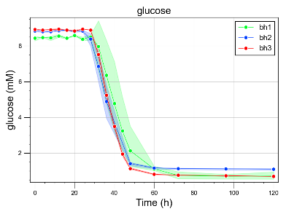
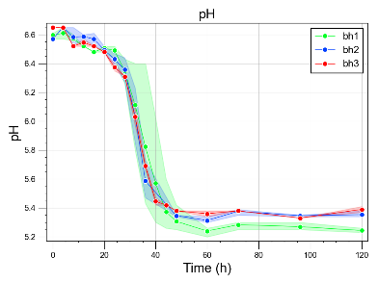
Growth
Nutrient uptake
By-product production
pH

Slide 22
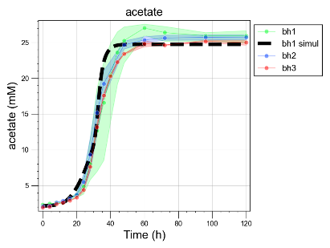






Growth
Nutrient uptake
By-product production
pH

Slide 23


Steady-state concentrations
(divided by the row max)
Simulate different dilution rates in a chemostat

Slide 24







faster dilution rate
slower dilution rate
State 1:
Steady state concentration of trehalose is sufficiently high
Bh glucose-consuming subpopulation does not form
Three species coexist, with Bh at low abundance
Higher butyrate, lower acetate concentration
State 2:
Steady state concentration of trehalose is low
Bh glucose-consuming subpopulation forms
Bh outcompetes Ri
Lower butyrate, higher acetate concentration
Tipping point

Slide 25



Hysteresis after feed stop perturbation

Slide 26


Slide 27


Slide 28


Slide 29






Slide 30
spatial structure
data
its mechanisms
a clear communication of results
biology
Ecology
evolution
Nothing in
makes sense, except in the light of

